Slide 1
Hermitage Parish AGM April 2022
The Challenge of Climate Change
Brian Hoskins
Chair, Grantham Institute - Climate Change and the Environment, Imperial College London
Professor of Meteorology, University of Reading

Slide 2
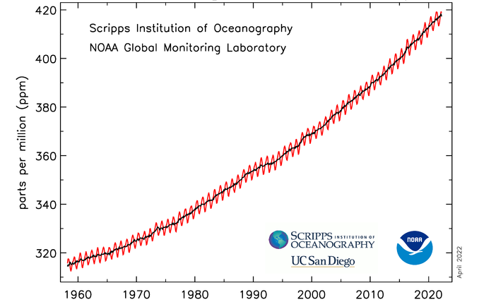
Measured Atmospheric Carbon Dioxide
Mauna Loa, Hawaii
The rise in carbon dioxide is due to our activities, mainly burning of fossil fuels
For every 100t of CO₂ emitted now, 15-40t will remain in the atmosphere in 1000y
Adding carbon dioxide to the atmosphere warms the climate now & in the future
Other GHGs (methane, nitrous oxide, FCs..) give the equivalent of 20% more CO2

Slide 3

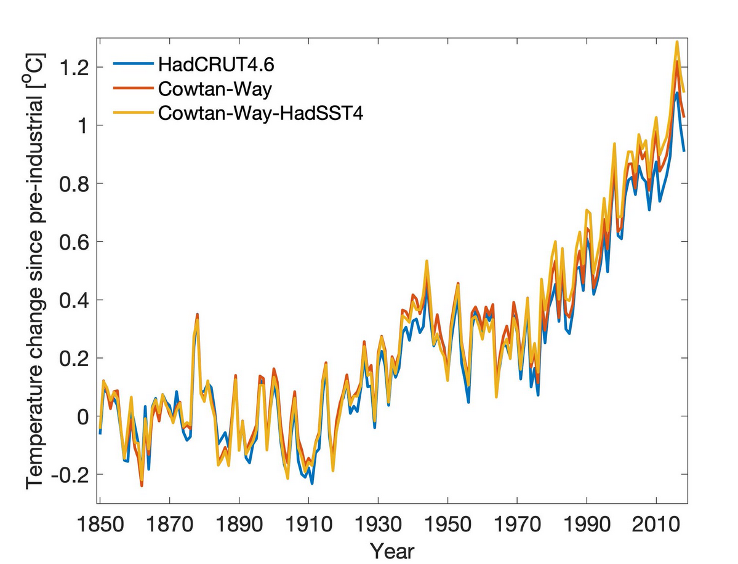
Moments of change
1.5ºC versus 2.0ºC
Source: UK Met Office
Source: https://showyourstripes.info/

Slide 4
Global Temperatures in the past 2000 years
IPCC WGp1 AR6

Slide 5
The Future?
Scenarios for CO2 emissions
Projections of temperature rise
2015
2050
2100
IPCC WGp1 AR6

Slide 6
IPCC WGp1 AR6
Projected Average Annual Changes at 4°C
Temperature
Precipitation

Slide 7
Much more about all English
regions on the web-site
Explore for yourself!

Slide 8
United Nations Framework Convention on Climate Change (UNFCCC)
Convention of the Parties (COP)
COP21 Paris 2015
Paris targets: Temperature rise less than 2°C with not more than 1.5 °C as ambition
Nationally Determined Contributions to GHG emission reduction (NDCs) given
Reassessment of NDCs every 5 years
Actual rules for targets vague and confusing

Slide 9
The UNEP Emissions Gap Report, 9 Nov 2021

Slide 10
COP26 Glasgow Nov 2021
Overall, COP26 achieved as much as realistically expected, with some pluses and some minuses.
The crucial tests of all the words spoken and promises made are:
Will the global greenhouse gas emission curve reach a maximum by the middle of this decade and be falling rapidly in 2030?
Are the developed countries now going to give substantial help to developing countries to cope with climate change and to pursue low carbon growth?

Slide 11
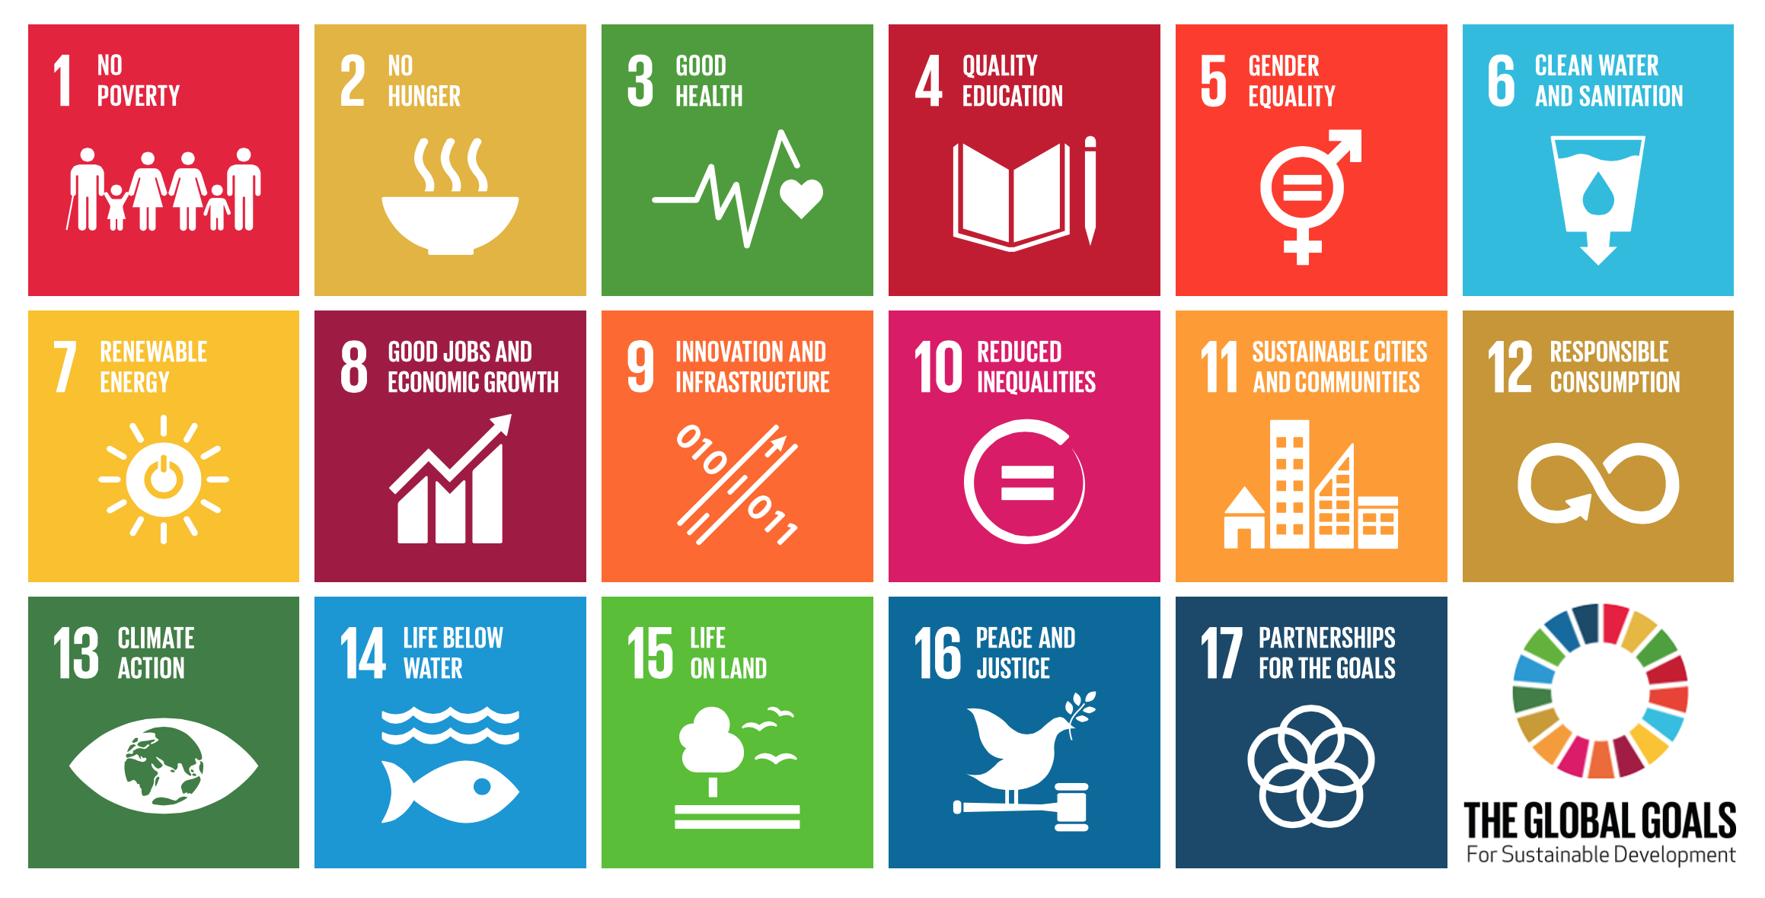
Wider Context
• growing world population •urbanisation • changing diet
• increased demand for food, water & energy • the biodiversity crisis
Sustainable Development Goals agreed at UN Sep 2015

Slide 12
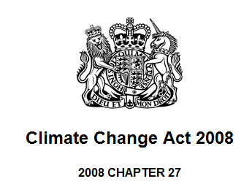
The UK Climate Change Act
80% reduction by 2050
5 year carbon budgets – legally binding
Requirement to develop policies and proposals to meet budgets
Established independent advisory body – Committee on Climate Change (CCC)
Climate change mitigation
-------------------------
Net Zero
5 yearly Climate Change Risk Assessment (CCRA)
& National Adaptation Plan
Preparing for climate change
www.theccc.org.uk
Notes:
The UK is unique in being the only country around the world that has introduced a long-term legally binding framework to tackle the dangers of climate change. The Climate Change Act received Royal Assent on 26 November 2008. This Act provides a legal framework for ensuring that Government meets its commitments to tackle climate change. The Committee on Climate Change (CCC) was set up as an independent body as part of the Act.
The Act requires that emissions are reduced by at least 80% by 2050, compared to 1990 levels. The 2050 target was raised to 80% from 60% following recommendations set out by the CCC in a letter to Secretary of State Ed Miliband in October 2008.
The Act also introduces legally binding carbon budgets, which will set a ceiling on the levels of greenhouse gases that can be emitted into the atmosphere. The CCC’s first report “Building a low-carbon economy” advises on the level of these budgets for the first three five year periods.
The CCC will monitor and report back to Parliament annually on progress made by Government in meeting carbon budgets. The CCC will publish its first progress report in September 2009.
The Climate Change Act 2008 also established the Adaptation Sub-Committee (ASC) as a new expert body to advise the Committee on Climate Change (CCC) on climate risks in the UK. The ASC will provide expert advice and scrutiny through that Committee to ensure that the Government’s programme for adaptation enables the UK to prepare effectively for the impacts of climate change.
From thesis:
The CCC was launched during a period of rapid increase in the public, political and scientific
debate regarding climate change both in the UK and internationally. In the UK, a significant
escalation in policy change with regards to climate change began with the Stern Review in October
2006 (Stern, 2006). The Stern Review on the economics of climate change demonstrated that the
benefits of strong, early action of climate change outweighed the costs (Stern, 2006). In 2008, the UK
framework for a comprehensive policy response was set in the Climate Change Act, which was
passed with bipartisan support on 26th November 2008 (Great Britain, 2008). This landmark act made
the UK the first country to enact legally binding reduction targets (DEFRA, 2008). It was under this
Act that the CCC was established.

Slide 13
UK Performance by Sector 2000-2020
CCC 2021

Slide 14
CCC 2021
Gap to target
if pre-2020 trends
continue in every sector

Slide 15

http://www.imperial.ac.uk/grantham/publications/infographics/
Make your voice heard
Eat less meat and dairy
Cut back on flying
Leave your car at home
Reduce your energy use and bills
Respect & protect open spaces
Invest your money wisely
Cut consumption & waste
Talk about the changes you make

Slide 16
Intergovernmental Panel on Climate Change (IPCC)
6th Assessment Report
Working Group 1 Report, Nov 2021
“Unless there are immediate, rapid, and large-scale reductions in greenhouse gas emissions, limiting warming to 1.5°C will be beyond reach.”
Working Group 2 Report, Feb 2022
“The scientific evidence is unequivocal:
climate change is a threat to human wellbeing & the health of the planet.
Any further delay in concerted global action will miss
a brief & rapidly closing window to secure a liveable future.”
Working Group 3 Report, Feb 2022
“The evidence is clear: the time for action is now.
We can halve emissions by 2030.”
“It’s now or never.”

Slide 17
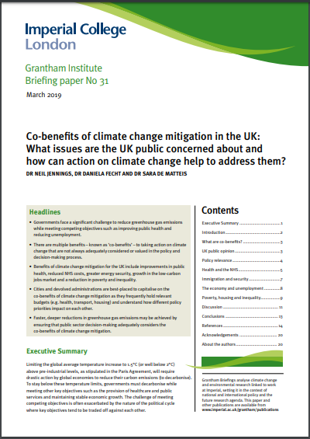

Co-benefits of climate action
www.ashden.org/programmes/co-benefits
Health and the NHS
Immigration and security
The economy and unemployment
Poverty, housing and inequality
http://www.imperial.ac.uk/grantham/publications/

Slide 18
Raising money
Buildings
Transport
Council’s estate
Power generation
Waste
Land use
Influencing others
https://ashden.org/wp-content/uploads/2020/08/31-Climate-Actions-for-Councils.pdf

Slide 19
CCC 2021

Slide 20
Projections of sea-level rise
In 2300, sea-level rises: ½-3m ; 2-7m, with 15m possible
IPCC WGp1 AR6

Slide 21
CCC 2021

Slide 22
Extreme Heat: Frequency & Intensity
IPCC WGp1 AR6

Slide 23
Intergovernmental Panel on Climate Change (IPCC)
6th Assessment Report
Working Group 1 Report, Nov 2021
“Unless there are immediate, rapid, and large-scale reductions in greenhouse gas emissions, limiting warming to 1.5°C will be beyond reach.”
Working Group 2 Report, Feb 2022
“The scientific evidence is unequivocal:
climate change is a threat to human wellbeing & the health of the planet.
Any further delay in concerted global action will miss
a brief & rapidly closing window to secure a liveable future.”
Working Group 3 Report, Feb 2022
“The evidence is clear: the time for action is now.
We can halve emissions by 2030.”
“It’s now or never.”

